Slide 1


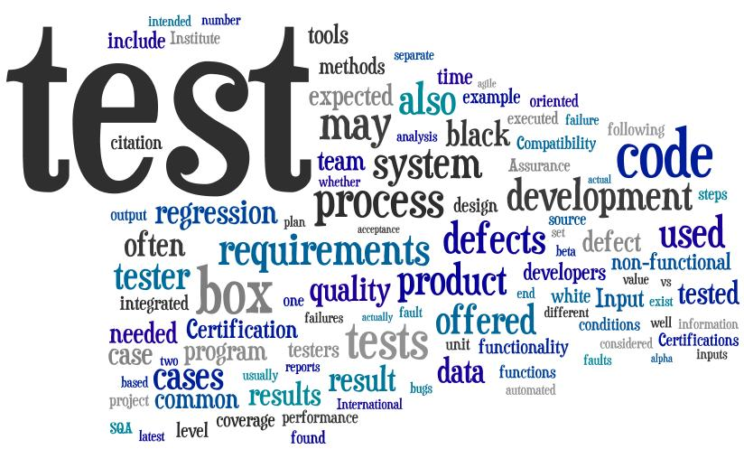

General Software Development
Testing
SoftUni Team
Technical Trainers
Software University
http://softuni.bg

Slide 2

Table of Contents
What are the testing methods:
Black-box testing
White-box testing
What are the testing levels:
Unit testing
Integration testing
System testing
Acceptance testing
Regression testing

Slide 3
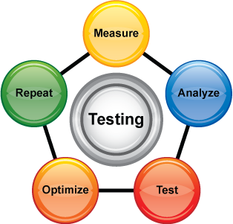
Testing
Testing is the process of analyzing a software item to detect the differences between existing and required conditions
A primary purpose of testing is to detect software failures so that defects may be discovered and corrected
Testing is done to ensure the quality of the software and its performance

Slide 4

Testing Methods

Slide 5
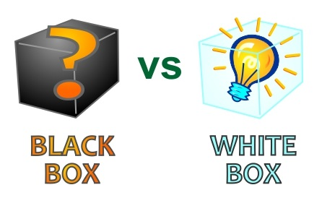
Testing Methods
Software testing is generally divided into 2 categories:
Black-box testing
Treats the software as a black box
White-box testing
The tester knows about the system internals

Slide 6

Black-box Testing
Black box testing takes an external perspective of the test object to derive test cases
Black box tests can be functional or non-functional, though usually functional
The test designer selects valid and invalid input and determines the correct output

Slide 7

White-box Testing
White-box testing uses an internal perspective of the system to design test cases based on internal structure
Requires programming skills to identify all paths through the software
Testers have access to the source code

Slide 8

Testing Levels

Slide 9

Testing Levels
Testing levels are defined by where the testing takes place within the course of the software development lifecycle
Unit testing
Integration testing
System testing
Acceptance testing
Regression testing

Slide 10

Unit Testing
Unit testing is a software testing method by which individual units of source code
Unit testing is white-box testing
Frequently done by the developer who is writing the code
Often uses an automated tool that can simplify the development of cases

Slide 11

Integration Testing
Integration testing is the phase in software testing in which individual software modules are combined and tested as a group
Takes as its input modules that have been unit tested
Can also involve testing the component’s interaction with an external system

Slide 12

System Testing
System testing is testing conducted on a complete, integrated system to evaluate its compliance with its specified requirements
System testing falls within the scope of black-box testing
Takes, as its input:
All of the "integrated" software components
The software system itself integrated with any applicable hardware systems

Slide 13

Acceptance Testing
Acceptance testing is a test conducted to determine if the requirements of a specification or contract are met
Often performed by the customers themselves
Two sub-levels:
Alpha testing
Available to limited group of users
Beta testing
Available to larger audiences

Slide 14
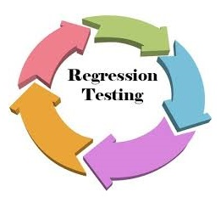
Regression Testing
Regression testing verifies that software previously developed and tested still performs correctly after it was changed or interfaced with other software
Common methods of regression testing include:
Rerunning previously completed tests
Checking whether program behavior has changed
Checking whether previously fixed faults have re-emerged

Slide 15

Summary
What is Software Testing?
What are the different Testing Methods?
What are the different Testing Levels?
To what testing methods do they classify?
What is the function of the test designers of this level?
What is every testing level’s function?
Why are they necessary?

Slide 16








Questions
https://softuni.bg/courses/javascript-applications/

